Slide 1

EDA CAPSTONE PROJECT
HOTEL BOOKING ANALYSIS
By
Dheeraj Budhlakoti
Saurabh Gaikwad
Bharat Gupta
Utsav Pataihe

Slide 2
PROJECT SUMMARY
Study of Hotel bookings related data is vital for any hospitality business as it gives insight into booking behaviour of customers as well as channels through which bookings are made.
This project involves the analysis of the provided data set pertaining to Hotel bookings for City and Resort Hotels.
Project activities have been categorised as under:
1. Defining the problem statement i.e. Business Objective of the study.
2. Collection and preparation of data by data cleaning , treating outliers etc.
3. Perform exploratory data analysis(EDA) through a deep study of relationship between different features, generate new variables based on need inline with related business objectives. Present the data in easily understandable form.
4. Provide observations as well as recommendations based on the EDA.

Slide 3
CONTENT
Problem Statement
About The Dataset
Variables Description
Python Libraries Used
Data Wrangling
EDA And Data Visualization
Objectives 01 - 23
Correlation Heatmap
Solutions/Suggestions To Achieve Business Objective
Conclusion

Slide 4
PROBLEM STATEMENT
An effort has been made in this project to analyse various aspects of booking behaviour by customers to answer various business challenges faced by hotel through rigorous study of:
1) Origination of guests i.e where do guests originally come from so that footfall from those countries can be further increased through additional public advertisements. Extra effort can also be made to retain them through personalised contact through emails, phone calls etc even after they leave.
2) Monthly booking pattern and find the busiest quarter/trimester of the year. This required to understand the need to increasing the temporary manpower to cater to extra load during busy months as well as increase promotions and adjust average daily rate to increase the occupancy during lean period.
3)Duration of the stay by various guests to provide smart pricing structure to increase stay.
4)Meal pattern to optimise the kitchen inventory and manpower requirement in cafeteria.

Slide 5
5)Study booking pattern by various market segments to encourage rewards and recognition for the ones providing more business.
6)Average Daily rate dependency on season,room type & allotment of demanded room type to optimise the price for greater occupancy.
7)Booking cancellation pattern considering various parameters like hotel type, lead time, season, deposit etc. to plan overbooking as well as devise means like penalty amount etc.
8) Customer retention pattern based on Hotel type to lay special emphasis on improving the experience to retain the customers.
Business Objective
Maximise Bookings, Minimise Cancellations , Maximise Customer retention as well as stay longevity.

Slide 6
ABOUT THE DATASET
The dataset given is a dataset from hotel industry, and we have to explore and analyze the data to discover important factors that govern the bookings and cancellations.
The goal is to analyze the dataset by exploring data provided under various column headings.
The above dataset has 119390 rows and 32 columns. There are no null values in any columns except for 4 columns (children, country, agent, company). The dataset also have 31994 duplicate values.

Slide 7
VARIABLES DESCRIPTION
Hotel: H1= Resort Hotel, H2= City Hotel
is_canceled : If the booking was canceled(1) or not(0)
lead_time : Number of days that elapsed between the entering date of the booking into the PMS(Property Management System) and the arrival date
arrival_date_year : Year of arrival date.
arrival_date_month : Month of arrival date.
arrival_date_week_number : Week number for arrival date.
arrival_date_day_of_month: Which day of the months guest is arriving.
stays_in_weekend_nights: Number of weekend nights (Saturday or Sunday) the guest stayed or booked to stay at the hotel.
stays_in_week_nights: Number of week nights (Monday to Friday) the guest stayed or booked to stay at the hotel.
adults : Number of adults.
children : Number of children.
babies : Number of babies.
meal: kind of meal opted for.
country : Country code.
market_segment: Through which channel hotels were booked.
distribution_channel : How the customer accessed the stay- Corporate Booking/Direct/TA.TO

Slide 8
is_repeated_guest : The values indicating if the booking name was from a repeated guest (1) or not (0).
previous_cancellations : Was there a cancellation before.
previous_bookings_not_canceled : Count of previous bookings not cancelled.
reserved_room_type : Code of room type reserved.
assigned_room_type : Code for the type of room assigned to the booking.
booking_changes : Count of changes made to booking.
deposit_type : Deposit type.
agent : If the booking happens through agents or not.
company : If the booking happens through companies, the company ID that made the booking or responsible for paying the booking.
days_in_waiting_list : Number of days the booking was on the waiting list before the confirmation to the customer.
customer_type : Booking type like Transient – Transient-Party – Contract – Group.
adr : Average Daily Rates that described via way of means of dividing the sum of all accommodations transactions using entire numbers of staying nights.
required_car_parking_spaces : How many parking areas are necessary for the customers.
total_of_special_requests : Total unique requests from consumers.
reservation_status: The last status of reservation, assuming one of three categories: Canceled – booking was cancelled by the customer; Check-Out;No-Show.
reservation_status_date: The last status date.

Slide 9
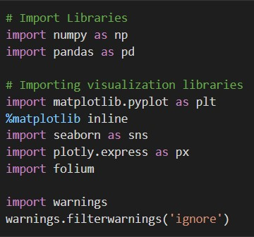
PYTHON LIBRARIES USED
Numpy
Pandas
Matplotlib
Seaborn
Plotly
Folium

Slide 10
DATA WRANGLING
First thing we did was, make a copy of original dataset to work on.
Now we had to clean this copied dataset and for that,
Firstly, we deleted all duplicated rows in copied Dataset.
Secondly, handled all null/missing values.
Then we changed the data types of columns to suitable data types.
Fixed more erroneous data.
Added new columns for better analysis.
Created to separate data frames for both our hotel types for easier comparison.

Slide 11
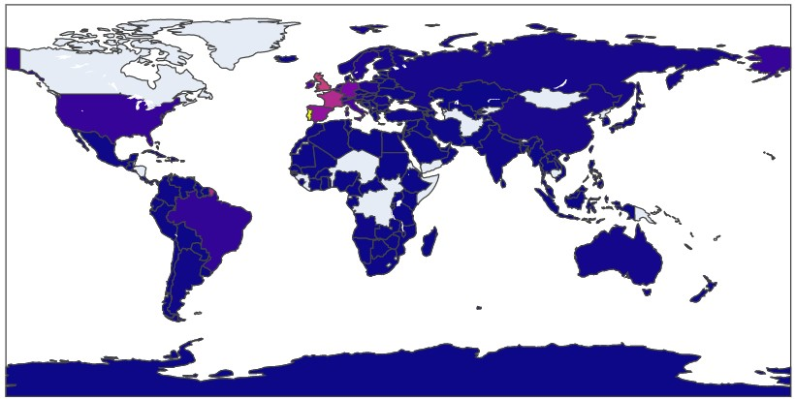
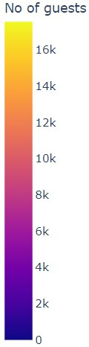
EDA AND DATA VISUALIZATION
Objective 01 - Where do the guests come from? From which country most guests come?

Slide 12
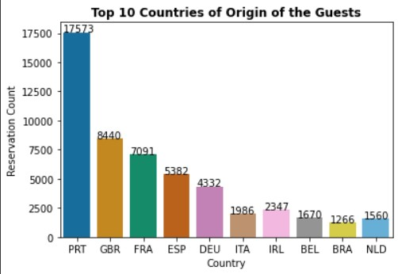
Remarks:
In First Plot we have used folium map and countplot from seaborn library in second one to depict the origination of visitors by their reservation Count.
Although people from about 166 countries visited the hotels,most of the guests are local i.e. from Portugal.
Among overseas visitors, European neighbours like United Kingdom, France, Spain, Germany, Italy had a lion's share.

Slide 13
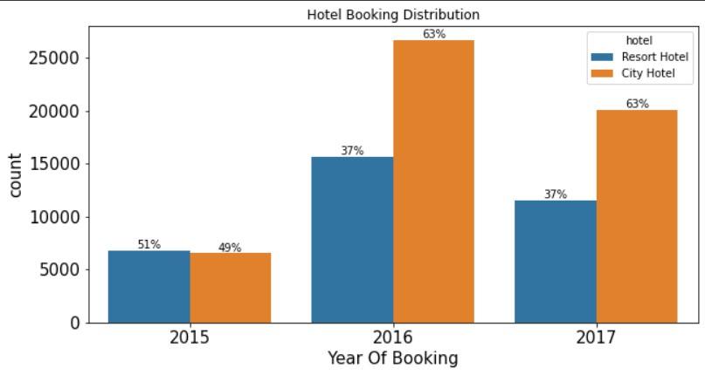
Objective 02 - What is the percentage of bookings for each hotel type for each year?
Remarks:
The graph we have used here is countplot form seaborn library which is a type of histogram used to visualize the counts of observations in each categorical bin using bars. Using count plot we can easily visualize and compare distribution of bookings for 2015, 2016 and 2017. And on top of that we have also compared the percentage of bookings for resort and city hotels.
From the graph we can conclude that in 2016 and 2017 city hotels received about 1.5 times more bookings than resort hotels while in 2015 bookings were quite low compared to 2016 and 2017 and also both city and resort hotels received equal no of bookings.

Slide 14
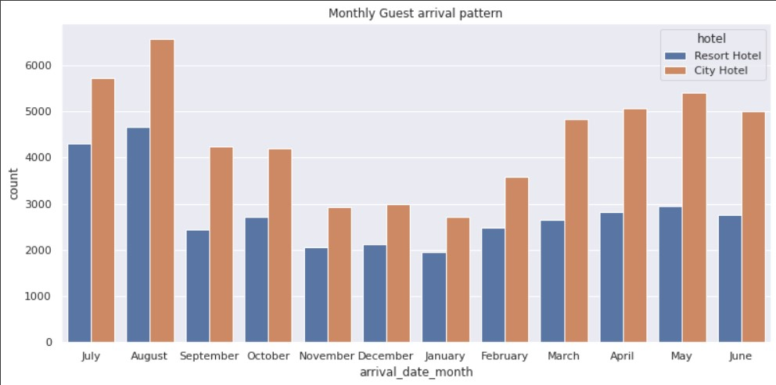
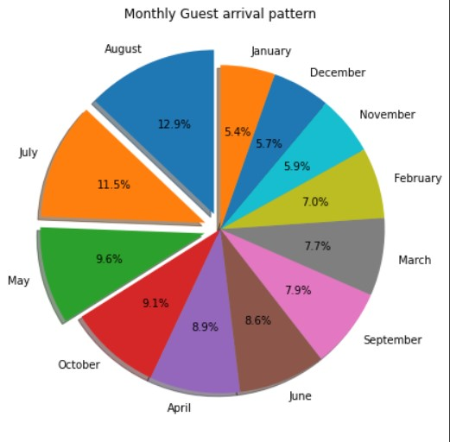
Objective 03 - Study Monthly arrival pattern of Guests to know Which are the busiest, moderate and least occupancy months?
Remarks:
Here in First graph we draw the Pie chart and in second chart the Count plot is drawn to show the explicit view of Monthly guest arrival. As above two graph display in August most guest are arrive followed by July and May. In second graph we observe that city hotel arrival count is more than Resort Hotel.

Slide 15
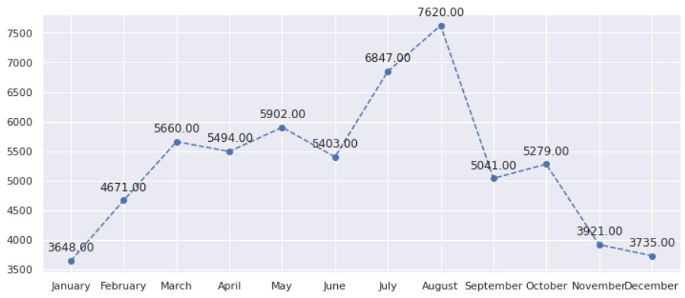
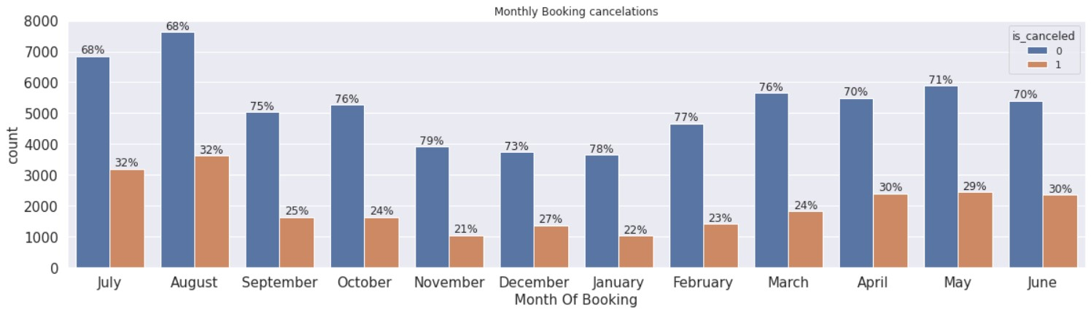
Objective 04 - Month Wise customers cancellation.
Remarks:
We have used two charts here, first one is a countplot and secondly linechart. We have used countplot from seaborn lib. so as to visualize comparison in canceled and not canceled bookings for each month. And secondly we have used line chart to visualize trend in monthly bookings(not canceled).
From these charts we can conclude that the months of July and August receive the most no. of bookings almost double as compared to January and December. And in other months the bookings remain constant around 5000.

Slide 16
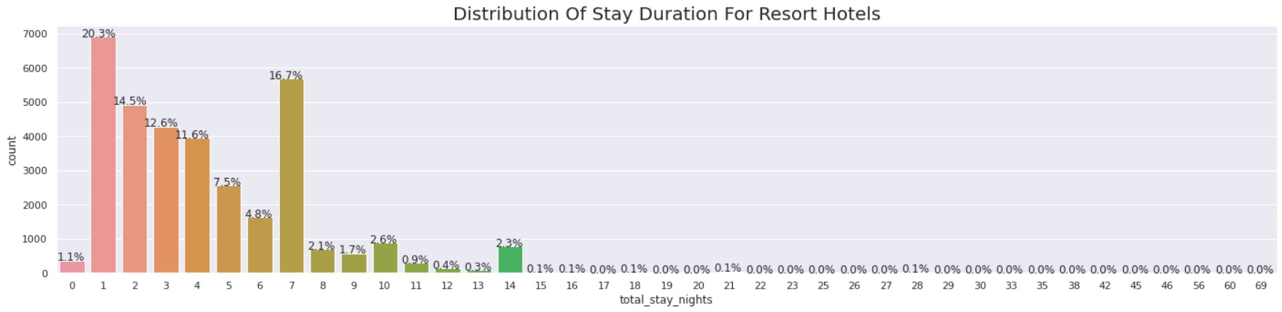
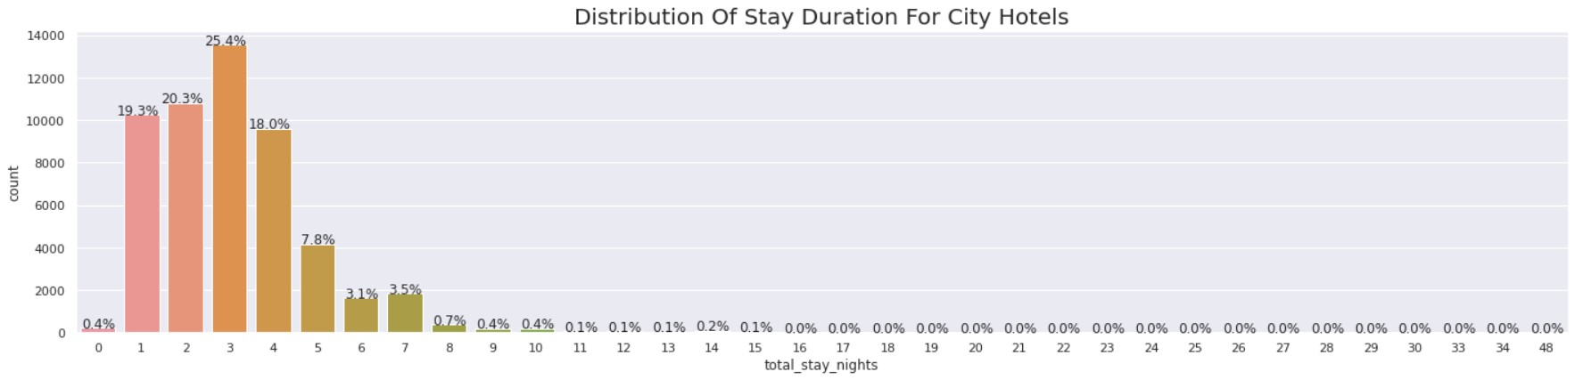
Objective 05 - How long do people stay at the hotels?
Remarks:
For this objective, Countplot has been used because as mentioned above it is best for visualizing the count of observations.We have plotted two graphs, one for Resort Hotels and the other for City Hotels.
From these we can conclude that in resort hotels most of the people stayed for a duration of just 1 day. While in case of city hotels the most people stayed for 3 days followed by 2 day and then 1 day. Duration of stay reduces drastically after week's stay for City hotels and reduces drastically after fortnight for resort hotels.

Slide 17
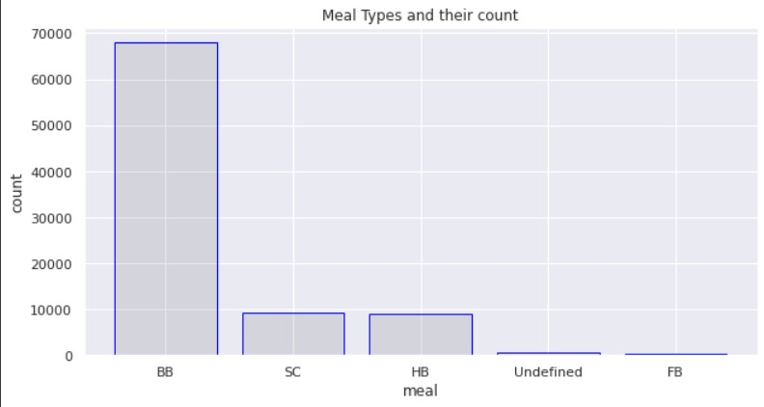
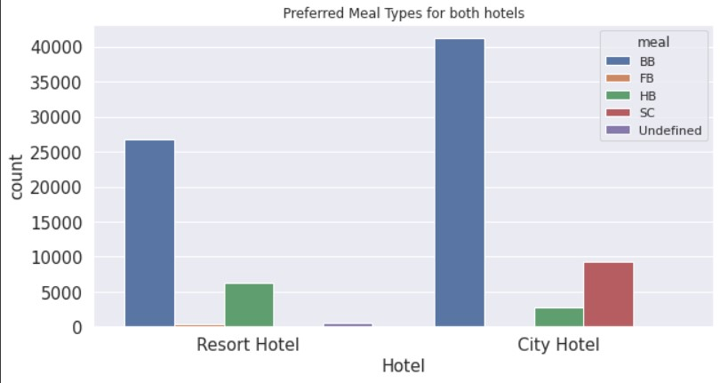
Objective 06 - Which meal type is most preferred meal of customer?
Remarks:
Here in the first graph, barplot has been used to show the relationship between a numeric and a categorical variable. And the second graph, Countplot has been used to show comparison among preferred meal types between both type of hotels.
It can be concluded that BB is the most preferred meal type for both the hotels. Followed by HB for Resort Hotel and SC for City Hotel.

Slide 18
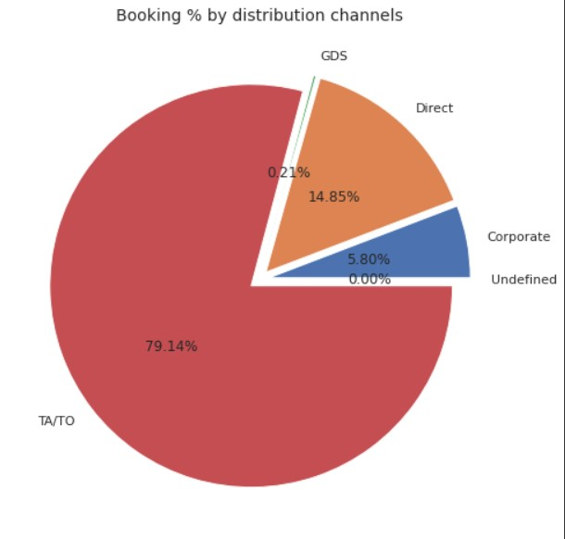
Objective 07 - What is the most common Distribution channel for booking hotels?
Remarks:
Pie chart has been used here to visualize the objective. So according to pie chart almost 80% of the bookings are done through Travel agents and Tour operators.
There is immense scope to increase the books through GDS(Global Distribution System ) as it is grossly underutilized with just 0.21% bookings.

Slide 19
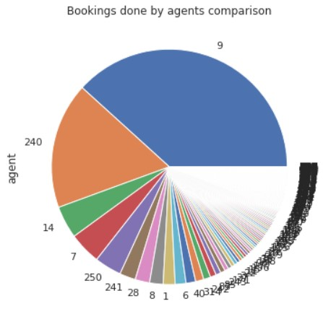
Objective 08 - Which agent makes the most number of bookings?
Remarks:
Pie Chart has been used to visualize which agent covers how much proportion of bookings. It is observed that agent 240 and 9 are the most valuable agents. Their total bookings combined account for more than 50% of total bookings done by agents
Note: Sorry for the distortion in graph image, it is happening due to a lot of small values present.

Slide 20
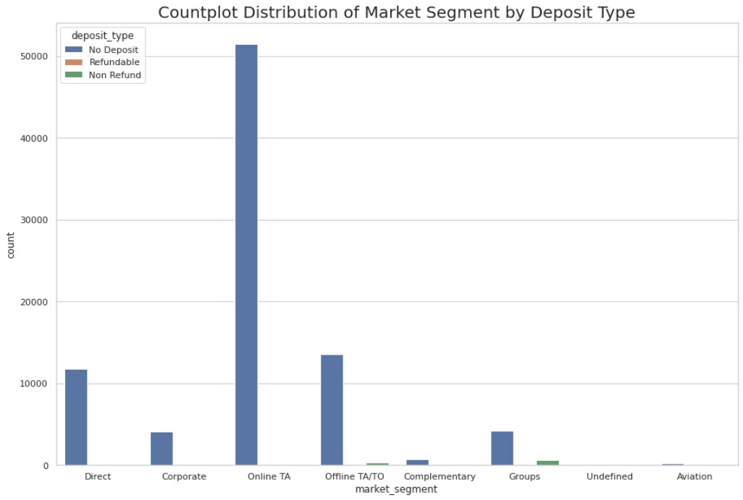
Objective 09 - What is the distribution of Market Segment based on Deposit Type?
Remarks:
Here Countplot fron sns i.e seaborn library has been used to display the distribution of Market segment By Deposit Type.
Most of the bookings are done for "No deposit" by all market segments. Few group bookings and Offline TA/TO Bookings are done through Non refundable deposits too.Refundable deposits are very less.

Slide 21
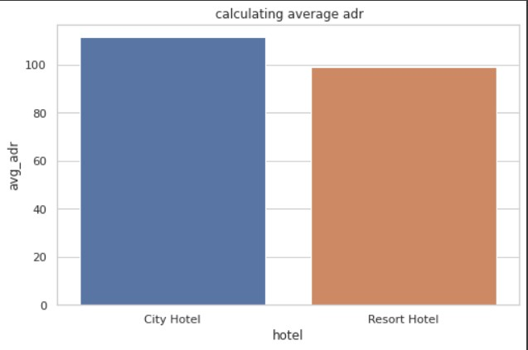
Objective 10 - Which hotel has more adr and hence seems to make more revenue?
Remarks:
In above Bar graph, comparison of both hotels with respect to adr i.e. average daily rate. And from the graph we can conclude that adr is greater in case of City Hotels as compared to Resort Hotels.

Slide 22
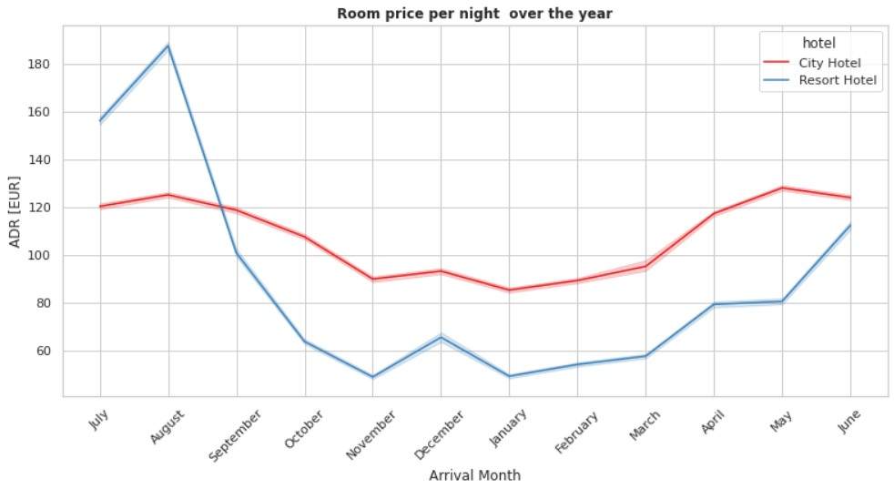
Objective 11 - How does the price per night vary over the year?
Remarks:
The graph here is Line Plot of seaborn library which is used to show how the prices per night vary for both hotel types.
From visualization we can observe that there is less variation in prices for city Hotels as compared to Resort Hotels. Prices for Resort Hotel are highest in August and least in November and January. For City hotel, prices are highest in May and least in January.

Slide 23
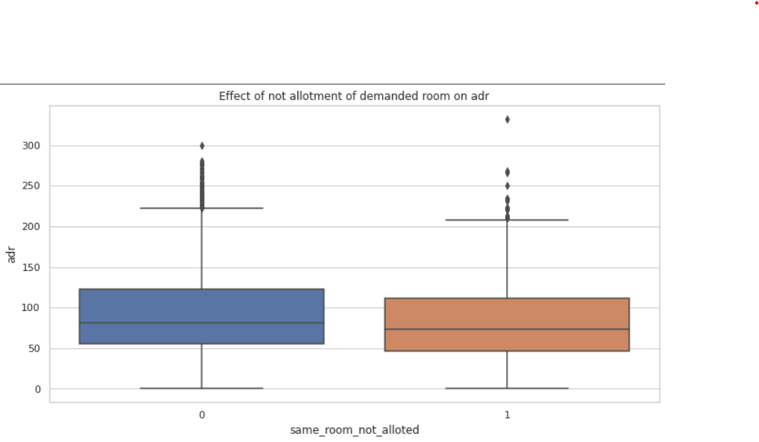
Objective 12 - Effect of non allotment of demanded room on adr?
Remarks:
BoxPlot is used as it is best Graph to display the Mean value on graph and the changes in the Averages. It is seen that effect of not allocating the same room reduces the adr.

Slide 24
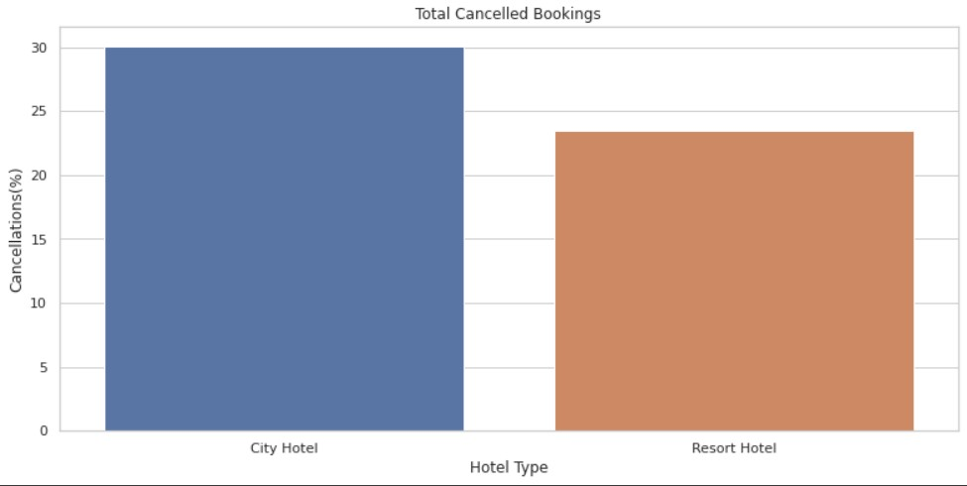
Objective 13 - How many bookings were cancelled?
Remarks:
Bar Graph has been used to display the average cancellations of city Hotel Count and Resort Hotel.
More bookings were cancelled for City hotels Got as compared to those for Resort Hotels.

Slide 25
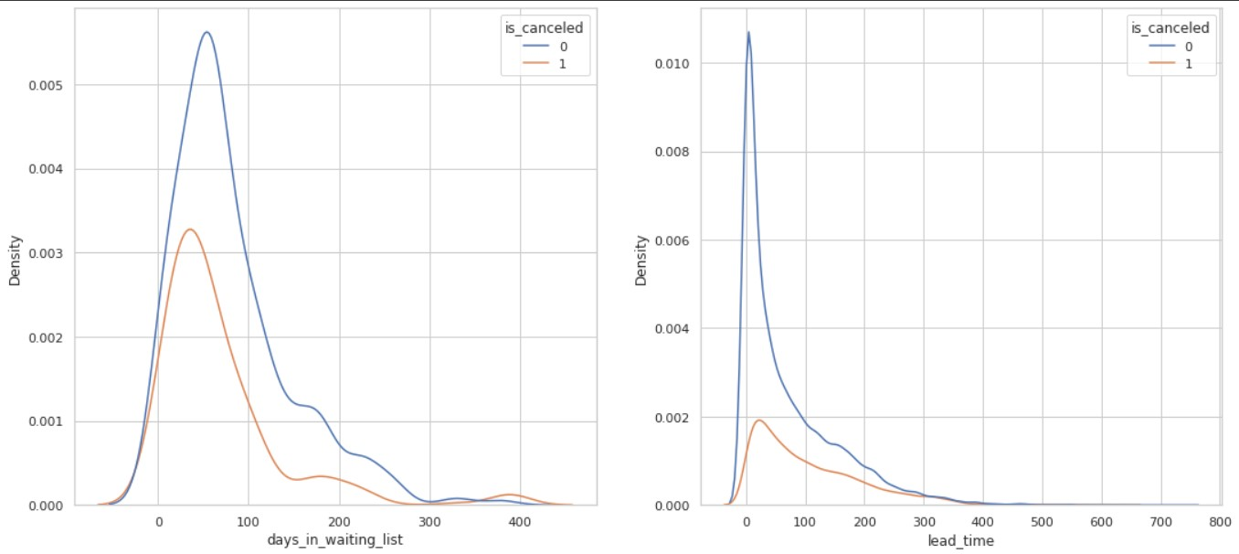
Objective 14 - Compare pattern of days in waiting list and lead time for both cancelled as well as availed stays.
Remarks:
kdeplot from seaborn has been used. We see that most of the bookings that are cancelled have waiting period of less 150 days but also most of bookings that are not cancelled also have waiting period less than 150 days. Both curves of cancellation and not cancellation are similar for lead time as well as days in waiting list i.e. if the value for cancelled bookings increases the one for not cancelled bookings also increases and same is true for decreasing values too. This holds good for both lead time as well as days in waiting list curves. The behaviour of curve beyond 300 days is different but can be ignored considering very low density of bookings.

Slide 26
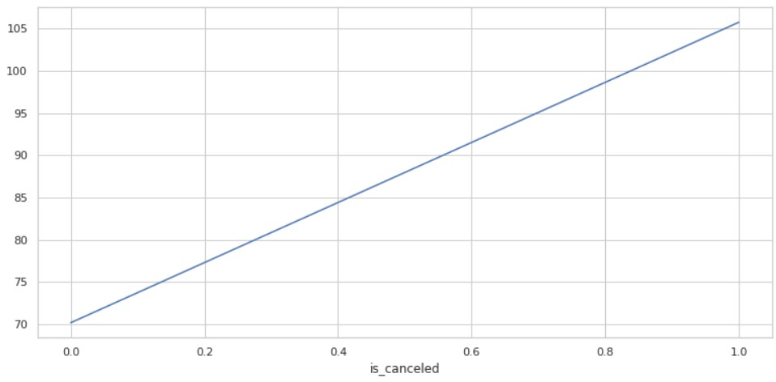
Objective 15 - Relationship of lead time with cancellation
Remarks:
Line chart has been used for this objective visualization.It is observed that most bookings which were canceled had a high lead time(average 105).
So we can conclude that bookings with higher lead time have higher chances of cancellation as compared to ones with lower lead time.

Slide 27
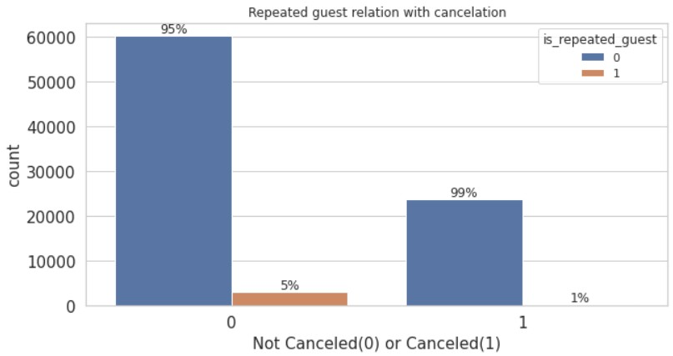
Objective 16 - Repeated guest effect on cancellation
Remarks:
Countplot has been used to visualize comparison between canceled and not canceled bookings by repeated and first time guests.
From the graph we found that 99% of the bookings that got canceled were by guests who were not repeated (first time guests). So we can safely conclude that repeated guest tend to cancel less than first time guests.

Slide 28
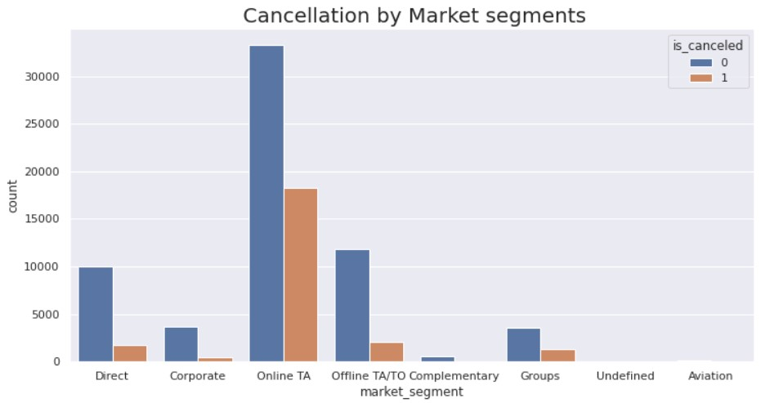
Objective 17 - What are cancellations by various market segments?
Remarks:
Countplot which is of seaborn library has been used to depict market segment wise cancellations. Online TA has did most cancellations as well as bookings. Cancellation and booking count is very less in case of undefined and aviation.

Slide 29
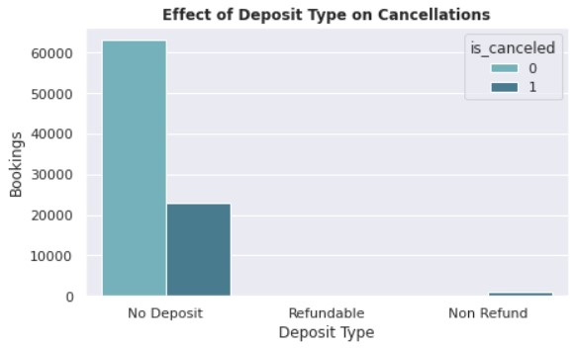
Objective 18 - What is the effects of deposit on cancellations?
Remarks:
The seaborn Countplot shows that most cancelations are done by the guests who have not given any deposit. However, some of the "Non refundable" ones cancelled their bookings too.

Slide 30
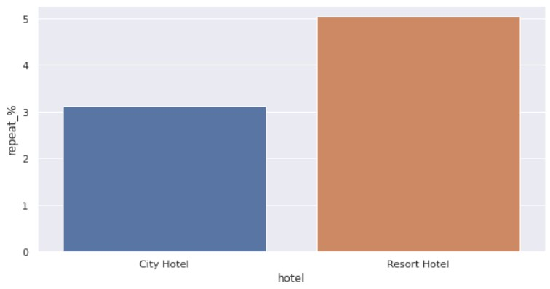
Objective 19 - Which hotel has a high chance that its customer will return for another stay?
Remarks:
Barplot has been used to display hotel wise repeat customer data. It has been found that Resort hotels have slightly more repeat customers(5%) compared to City hotels(3%).

Slide 31
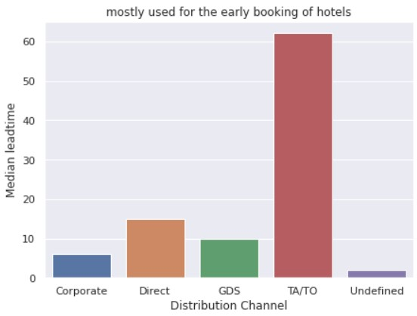
Objective 20 - Which channel is mostly used for the early booking of hotels?
Remarks:
The barplot is used for showing the Distribution channel by Median Lead time that is which channel is mostly used for the early booking of hotels. Early bookings are done mostly by TA/TO followed by Direct ,GDS and corporate.

Slide 32
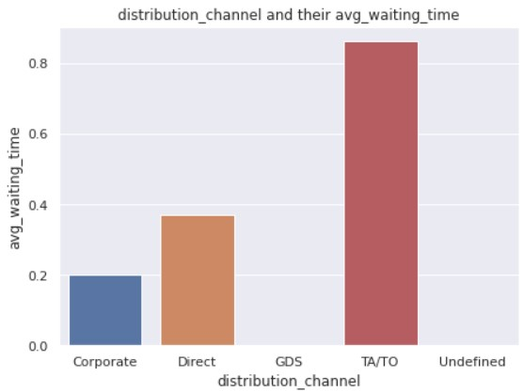
Objective 21 - Which has a longer average waiting time?
Remarks:
In this Bar Graph for various distribution channels, average waiting time for TA/TO is highest followed by Direct and corporate. Waiting time for GDS is negligible. This might be because of no. of bookings itself for GDS are very less , hence waiting time is less too.

Slide 33
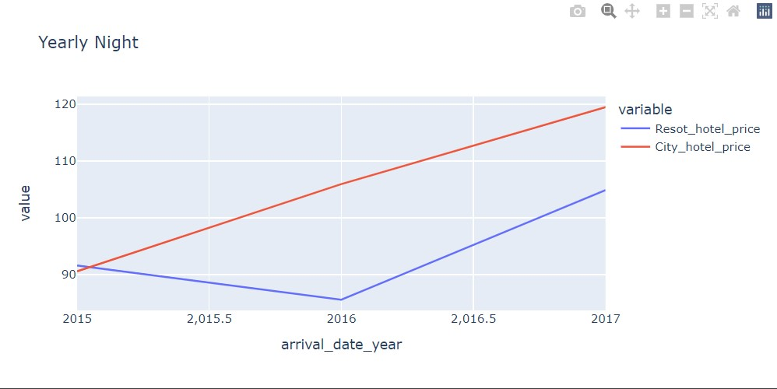
Objective 22 - How does the price per night changes yearly?
Remarks:
The above Line graph displays City Hotel Prices are constantly increasing throughout different years but in the case of Resort hotels at the beginning the price is high but as we go into 2016 the price is going down and again in the middle of 2016 and 2017 the prices go up.

Slide 34
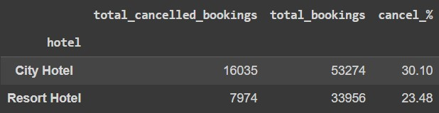
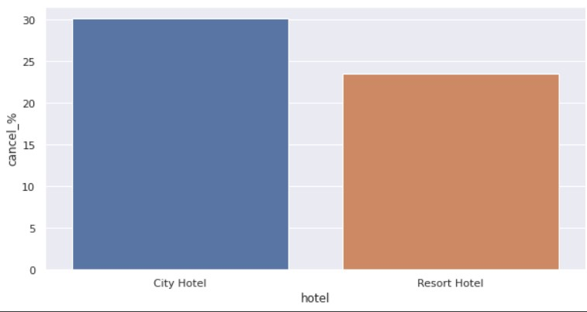
Objective 23 - Which hotel has higher booking cancellation rate?
Remarks:
The Bar Graph display, City hotel has higher cancellation rate which is 30.1% as compared to Resort Hotel's 23.48%.

Slide 35
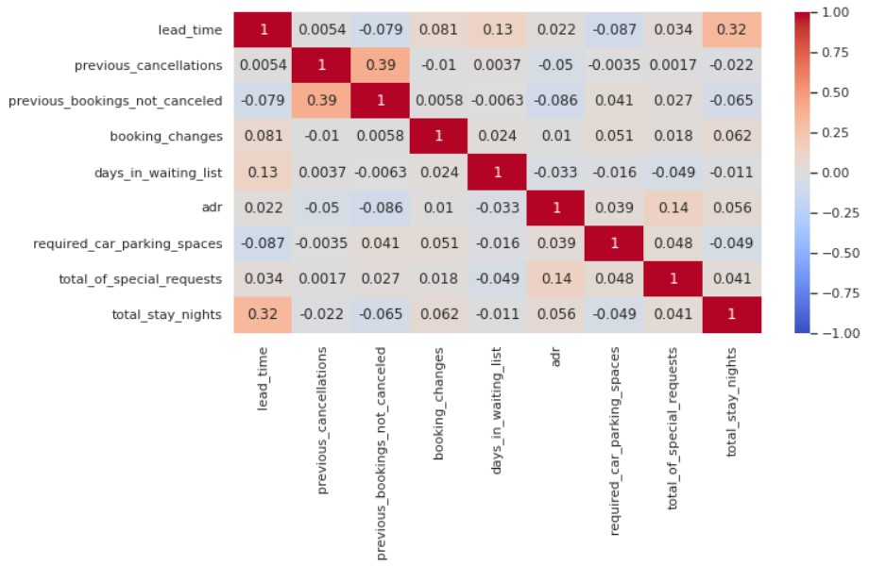
CORRELATION HEATMAP
Remarks:
We have used heatmap here, because it is considered one of the best chart to visualize correlation between different variables in a dataframe. And from this heatmap we can clearly see that the highest correlation value is 0.39.

Slide 36
Solutions/Suggestions To Achieve Business Objective
Our business objective was to increase bookings, decrease cancellations, and increase customer retention while also extending stays. Based on our investigation, some recommendations we came up with are as follows:
Additional public marketing can help raise the number of visitors from * certain nations. Even after they depart, more effort can be taken to keep them by keeping in touch with them by personalised emails, phone calls, etc.
Agents and market sectors that bring in more clients should also be recognised with awards and incentives.
Cancellations had a strong connection with new clients. If new clients are prone to cancel, further efforts should be taken to retain them by providing discounts and offers. Additionally, greater efforts should be made to retain clients as Repeated clients generally cancel less bookings.
Data from each visitor's stay can be used to send them personalized offers to maximize their chances of booking again.
Launching customer loyalty programmes to reward loyal customers.
The period of each visitor's stay can be utilized to create a clever pricing model that should prolong one‘s stay.
Extra efforts should be made to foster positive relationships with clients which can be done by sending them engaging emails, such as "Thank you" and "Happy Holidays",etc.
Good customer evaluations can have a significant impact on a hotel's brand value, and it is important to consider customer feedback and reviews in order to improve hotel amenities and the guest experience.

Slide 37
CONCLUSION
1) Most of the guests are local i.e. from Portugal. Among overseas visitors, European neighbours like United Kingdom, France, Spain, Germany, Italy had maximum footfall. Least number of visitors came from Countries like Zambia, Madagascar, Seychelles, Faroe Islands etc. Hence there is scope to increase footfall from these countries from where number of customers were less.
2) Barring 2015, almost 2/3rd of the bookings were for City Hotels for each year. This may be due to frequent business travellers as well as easy accessibility.
3) Monthly visit pattern shows a "wave like" pattern where months of July & August were heavily visited and November, December, January were least visited. Other months were moderately visited.
4) For all the months, at least 21% of bookings were cancelled. Percentage of cancellation was least in least visited months of Nov , December, January and was most in heavily visited months. Hence there is scope of overbooking for all Heavily visited as well as moderately visited months.
5) Duration of stay reduces drastically after week's stay for City hotels and reduces drastically after fortnight for resort hotels.Resort hotels seem to be visited for stays either on weekend or weekly or fortnightly basis. People use city hotels mostly for short stays(1-4 days). Special customised Packages can be suggested to increase the stay duration.
6) Breakfast is most preferred meal type followed by Breakfast+Dinner and Self catering. Therefore customer experience has to be taken special care during timings of these meals as well as availability of utensils, gas in kitchen or kitchenette where guests can prepare their own food.

Slide 38
7) Almost 80% of the bookings are done through Travel agents and Tour operators. There is immense scope to increase the books through GDS(Global Distribution System ) as it is grossly underutilized with just 0.21% bookings.
8) Lion's share of agent bookings is done by 2 agents (Agent 9 & 240 ). Also, 75% of the bookings are done by just 8 agents. Therefore there is immense scope to increase bookings by other agents. Also special care needs to be taken to provide best services to these two agents providing most business.
9) Most of the bookings are done without deposit by all market segments. However some group bookings and Offline TA/TO Bookings are done through Non refundable deposits too. Refundable deposits are miniscule and hence can be ignored.
10) City hotels have higher adr and hence make more revenue per room w.r.t Resort hotels.
11) Price per night is dependent on season.Heavily booked months have highest adr.
12) Not allotment of demanded room lowers the adr i.e. price for room for customers except for few customers who have paid more adr even when they were not allotted the same room. These customers do not seem to cancel their visit plans in spite of different room allotment.
13) Cancellation rate of City hotel is around 30%. Cancellation rate of Resort Hotels is around 20% lesser than that of city hotels.
14) Cancellation shows similar pattern w.r.t. waiting list period as well as lead time. Most of the bookings which were cancelled as well as those not cancelled show similar waiting time as well as lead time values.

Slide 39
15) Cancellations are more for higher average lead times (80 days). For lower average lead times (70 or less) there are no cancellations as people seem to have firm visit plans.
16) Repeated guest tend to cancel less as compared to those visiting for first time. This might be true because of their prior satisfactory experience with the hotel. Effort should be made to retain customers to reduce chance of cancellations too.
17) Most cancellations are done by Online TA followed by Offline TA/TO, Direct groups and corporate. Complementary segment has no cancellations.
18) Guests who did not pay any deposit cancelled most of the bookings. An incentive of reduced adr can be given to customers who give deposit and furthermore reduced adr to those who give non refundable deposits.
19) Resort hotels have slightly more repeat customers as compared to City hotels. Therefore there is ample scope for city hotels to improve their services to increase repeated footfall.
20) Early bookings are done mostly by TA/TO followed by Direct, GDS and corporate. This might be because of visits by corporate at relatively shorter notice.
21) Among distribution channels, average waiting time for TA/TO is highest followed by Direct and corporate. Waiting time for GDS is negligible. This might be because of no. of bookings itself for GDS are very less, hence waiting time is less too.
22) Adr for city hotels have been increasing every year. For resort hotel price dipped in 2016 but bounced back and increased appreciably in the succeeding year.
23) City hotel has higher cancellation rate as itineraries of the customers visiting seem to change frequently leading to more cancellations.

Slide 40
Thank You…

